Slide 1


UA Innovate: Data Analysis
Notes:
Southern Company's telecommunications team handles complex tasks across diverse domains, including microwave/RF backhaul, fiber optics, DWDM, MPLS networks, and more. To optimize productivity and resource allocation, we must effectively utilize work management data for actionable insights.

Slide 2
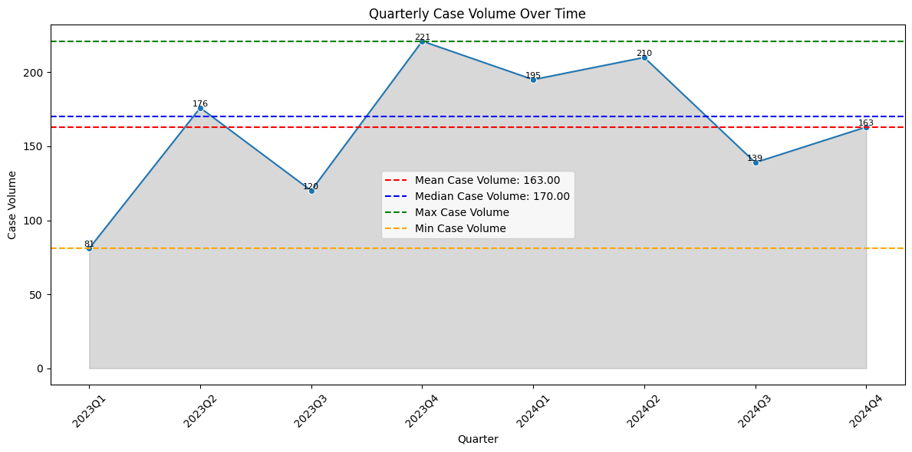
Case Volume by Quarter
Understanding Productivity:
Track periods of high and low CRQ volumes to optimize resource allocation
Compare actual CRQ volumes against mean and median values to assess consistency
Why These Metrics Are Needed for Southern Company:
Helps Southern Company allocate resources more effectively during peak times and implement process improvements during low productivity periods
Provides benchmarks for evaluating performance and identifying areas for improvement, supporting continuous enhancement of operations

Slide 3
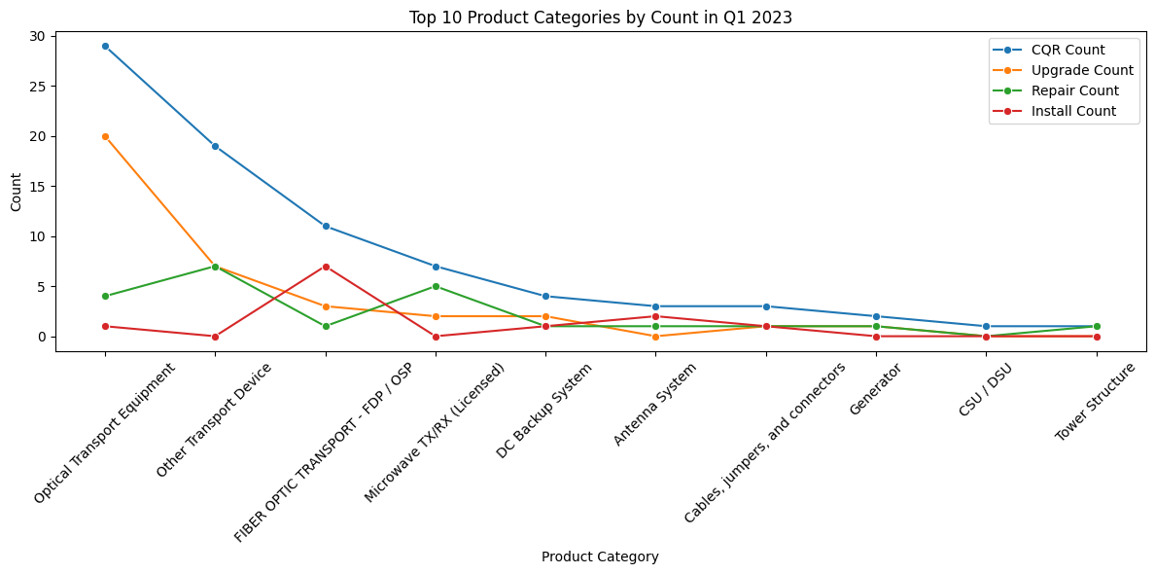
Top 10 Product Categories by Count in Q1 2023
The graph categorizes the top 10 product types by counts of CQR (change request queries), Upgrades, Repairs, and Installations in Q1 2023
Tracking Upgrade Count and Install Count highlights areas where new technologies or systems are being deployed.
This data helps identify if specific equipment types are prone to failure, impacting reliability of Southern Company's critical infrastructure (AMI, LINC, etc.)
High CQR volume might indicate process inefficiencies in change requests that need streamlining
A high upgrade count in "Optical Transport Equipment" suggests significant system changes requiring careful planning

Slide 4
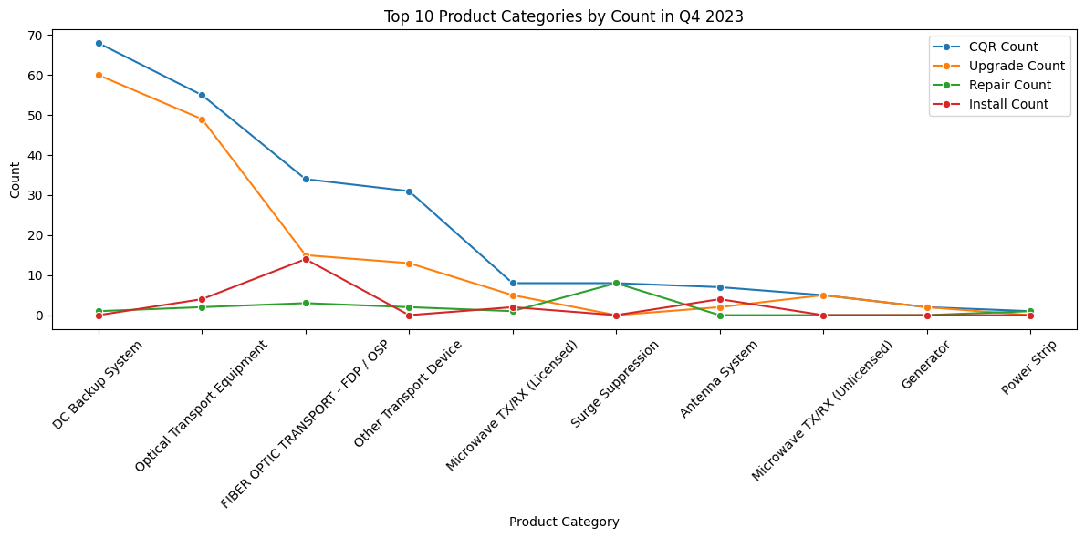
Top 10 Product Categories by Count in Q4 2023
Highlights the volume of CRQs (change request queries) across different product categories in Q4 2023
High CRQ volume in areas like "DC Backup System," "Optical Transport Equipment," and "Fiber Optic Transport" suggests potential bottlenecks or areas needing attention. Understanding this distribution allows targeted improvements
A large increase in CRQs related to "Microwave TX/RX (Licensed)" after a frequency change suggests potential interference or configuration problems
A surge in "Fiber Optic Transport" CRQs after a network upgrade may indicate compatibility issues or installation errors

Slide 5
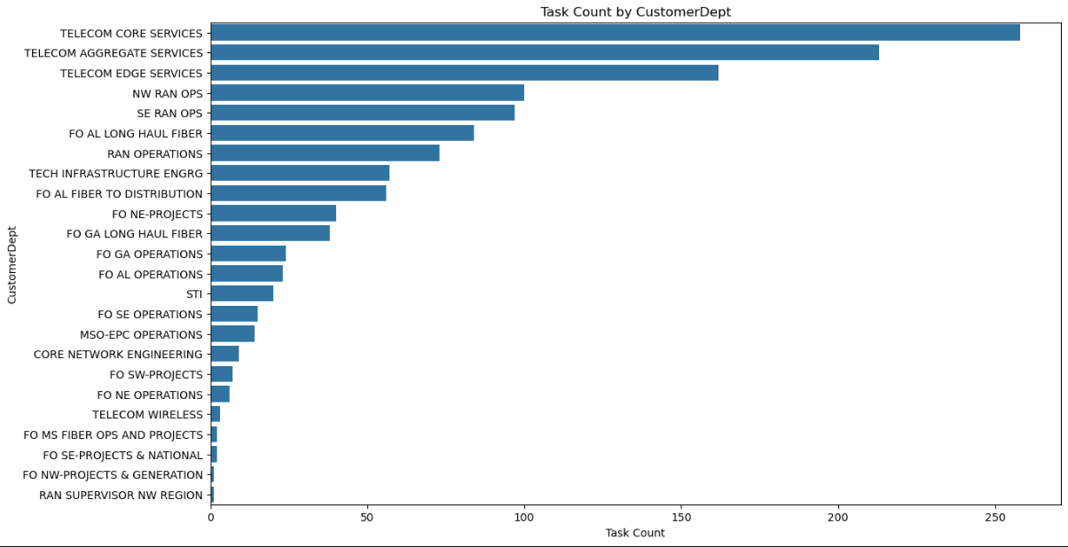
Workload Distribution by CustomerDept
Purpose: Understand how tasks are distributed among employees and departments.
Why It's Needed:
Resource Allocation: Identify departments needing more resources.
Efficiency Improvement: Plan and distribute tasks better.
Balanced Workload: Prevent departments from being overwhelmed.

Slide 6
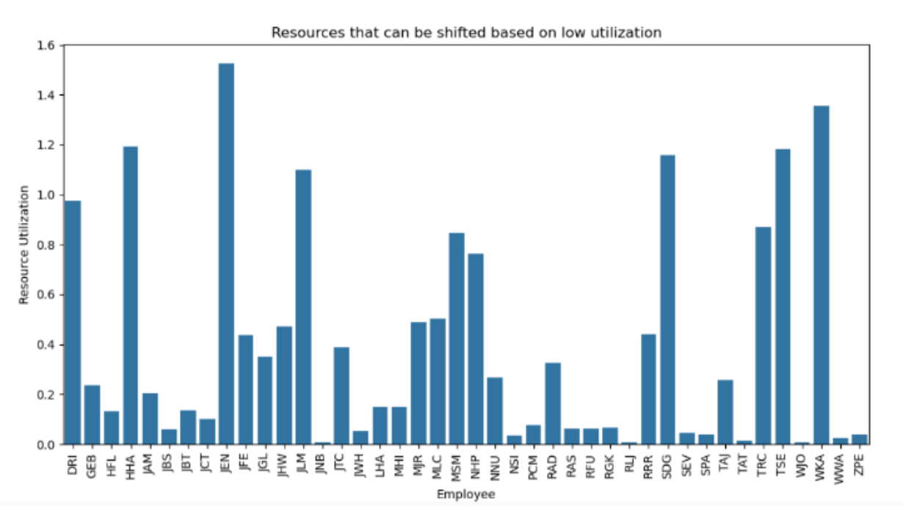
Employee Resource Utilization
Purpose: Measure how efficiently employees are using their available time.
How It Works:
Calculated total time spent on tasks by each CustomerDept.
Defined total available time ( 20 working days x 8 hours/day).
Why It's Needed:
Identify Bottlenecks: Detect departments with high utilization rates.
Aid in planning and prioritizing tasks based on workload.

Slide 7
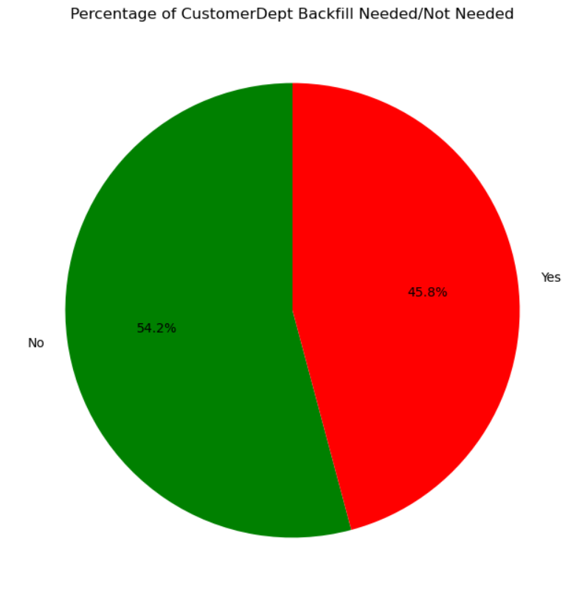
Do you need to backfill an employee?
How do we determine this?
Calculate Workload and Utilization:
Workload: Count the number of tasks assigned to each employee.
Utilization: Calculate the total hours spent on tasks divided by the total available working hours.
Set Thresholds: Calculated thresholds for workload (48.70) and utilization (1.75) that indicate when an Company Department is overburdened.
Determine Backfill Need: Compare each department workload and utilization against the thresholds. If either exceeds the threshold, a backfill is needed.

Slide 8
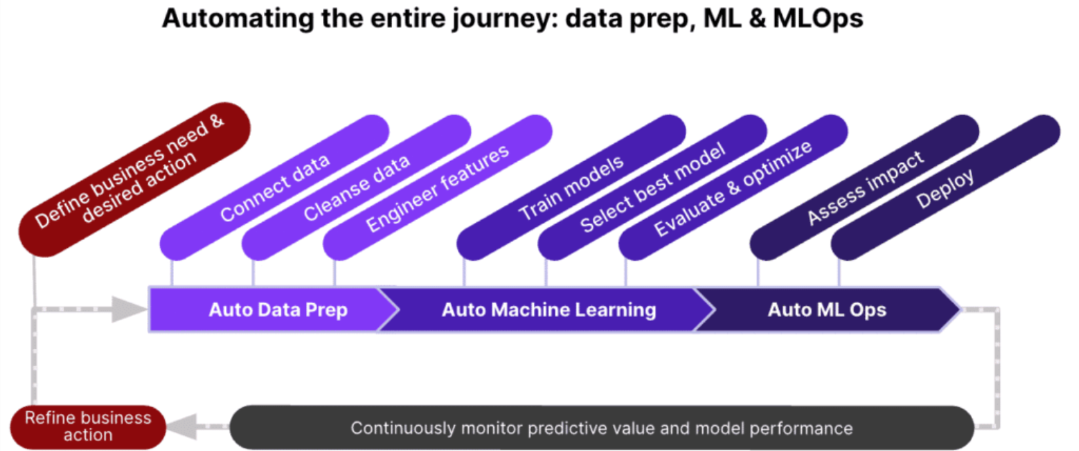
Automated Predictive Analysis
Benefits of Automation:
Improved efficiency and accuracy.
Time-saving by reducing manual tasks.
Consistent and repeatable results.

Slide 9
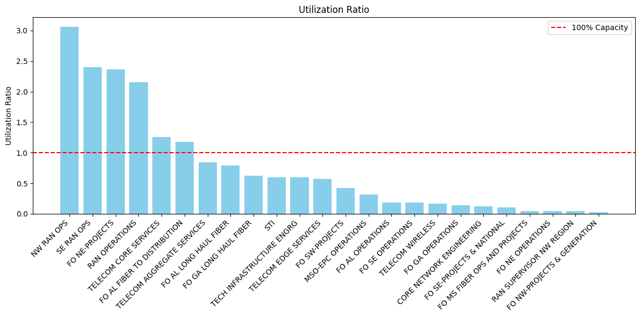
Determining if our teams are right-sized
Utilization Ratio: Ratio between total actual hours worked on CRQ/ total possible hours based on 40-hr work week
reveals whether a team is operating near or above capacity, indicating if it is understaffed or has spare capacity.

Slide 10
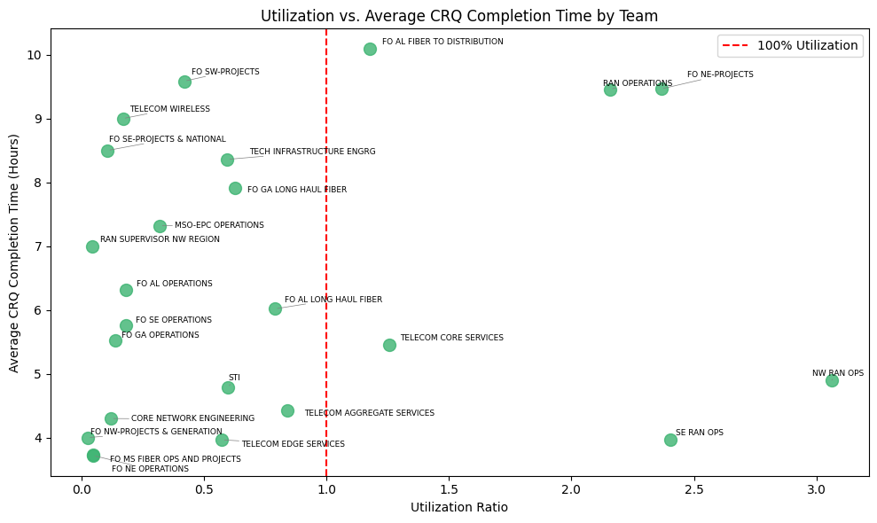
How does utilization affect CRQ completion time?
compares each team’s utilization against their average task completion time, highlighting which teams are stretched thin (high utilization and longer durations) versus those with capacity.
enables leaders to spot differences in efficiency and workload fluctuations that inform project prioritization and staffing adjustments

Slide 11
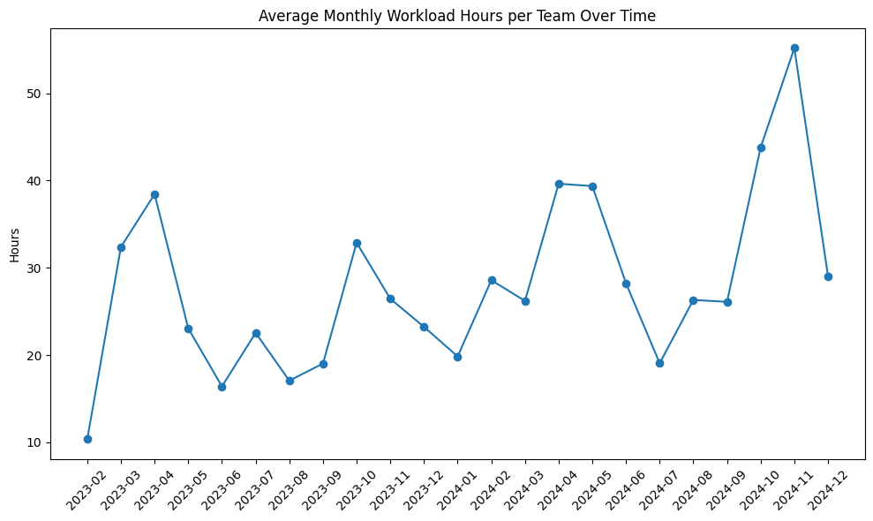
How can we help leaders plan and prioritize projects based on workload?
Reveals seasonal peaks and increasing demand to inform project scheduling.
Guides prioritization and staffing decisions by aligning projects with current and predicted team workload.

Slide 12
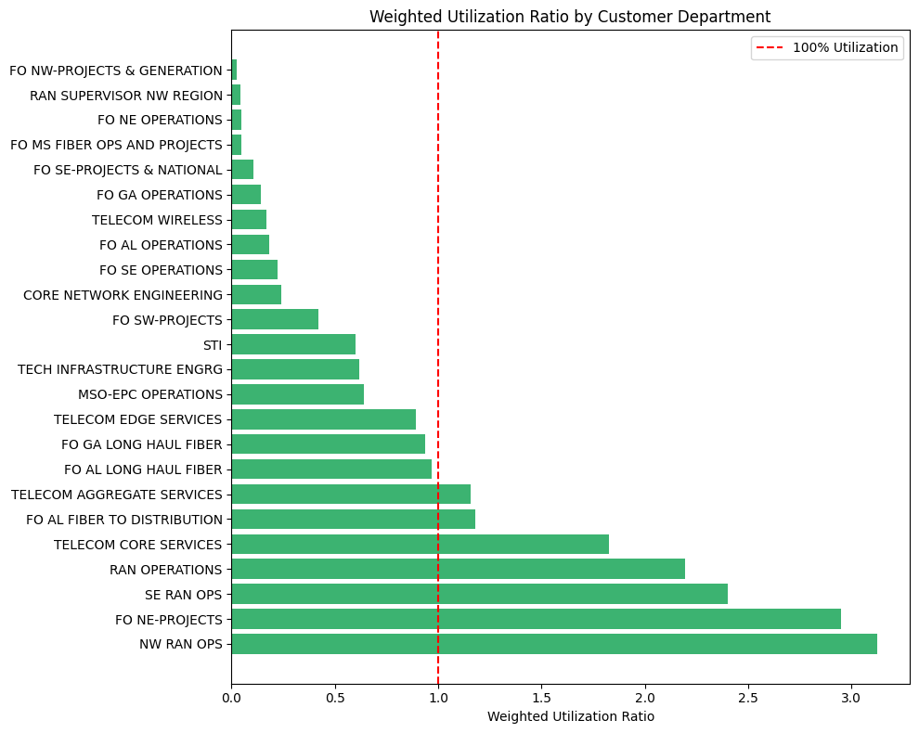
Weighted Utilization
Highlights overutilized teams (weighted utilization >100%) to guide strategic reallocation and project prioritization.
Adjusts raw hours by task impact, revealing the true burden on each department relative to their staffing capacity.

Slide 13
Questions?

